Slide 1
How to do datamerge

Slide 2
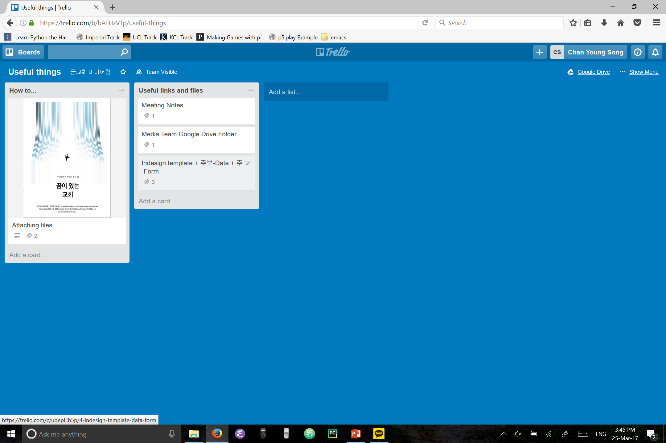
You need 3 files:
1. The “주보-Datamerge” indesign template.
2. “주보-Data” excel file
They are both is on Trello –> Useful things -> “Indesign template + 주보-Data + 주보-Form”
3. “주보-Form” excel file which 목사님 will email us with the filled forms.

Slide 3
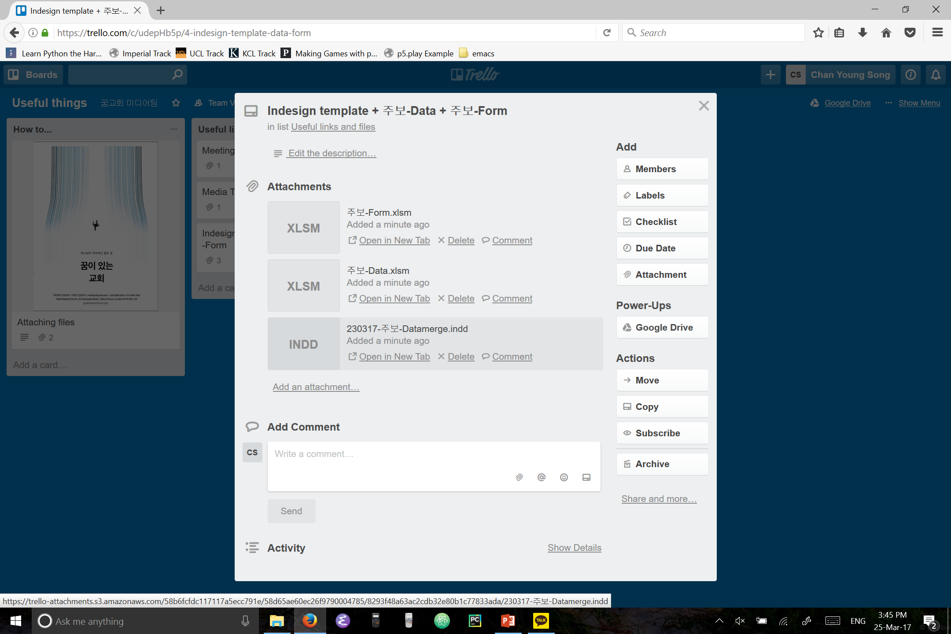
If you don’t have them already, download them.

Slide 4
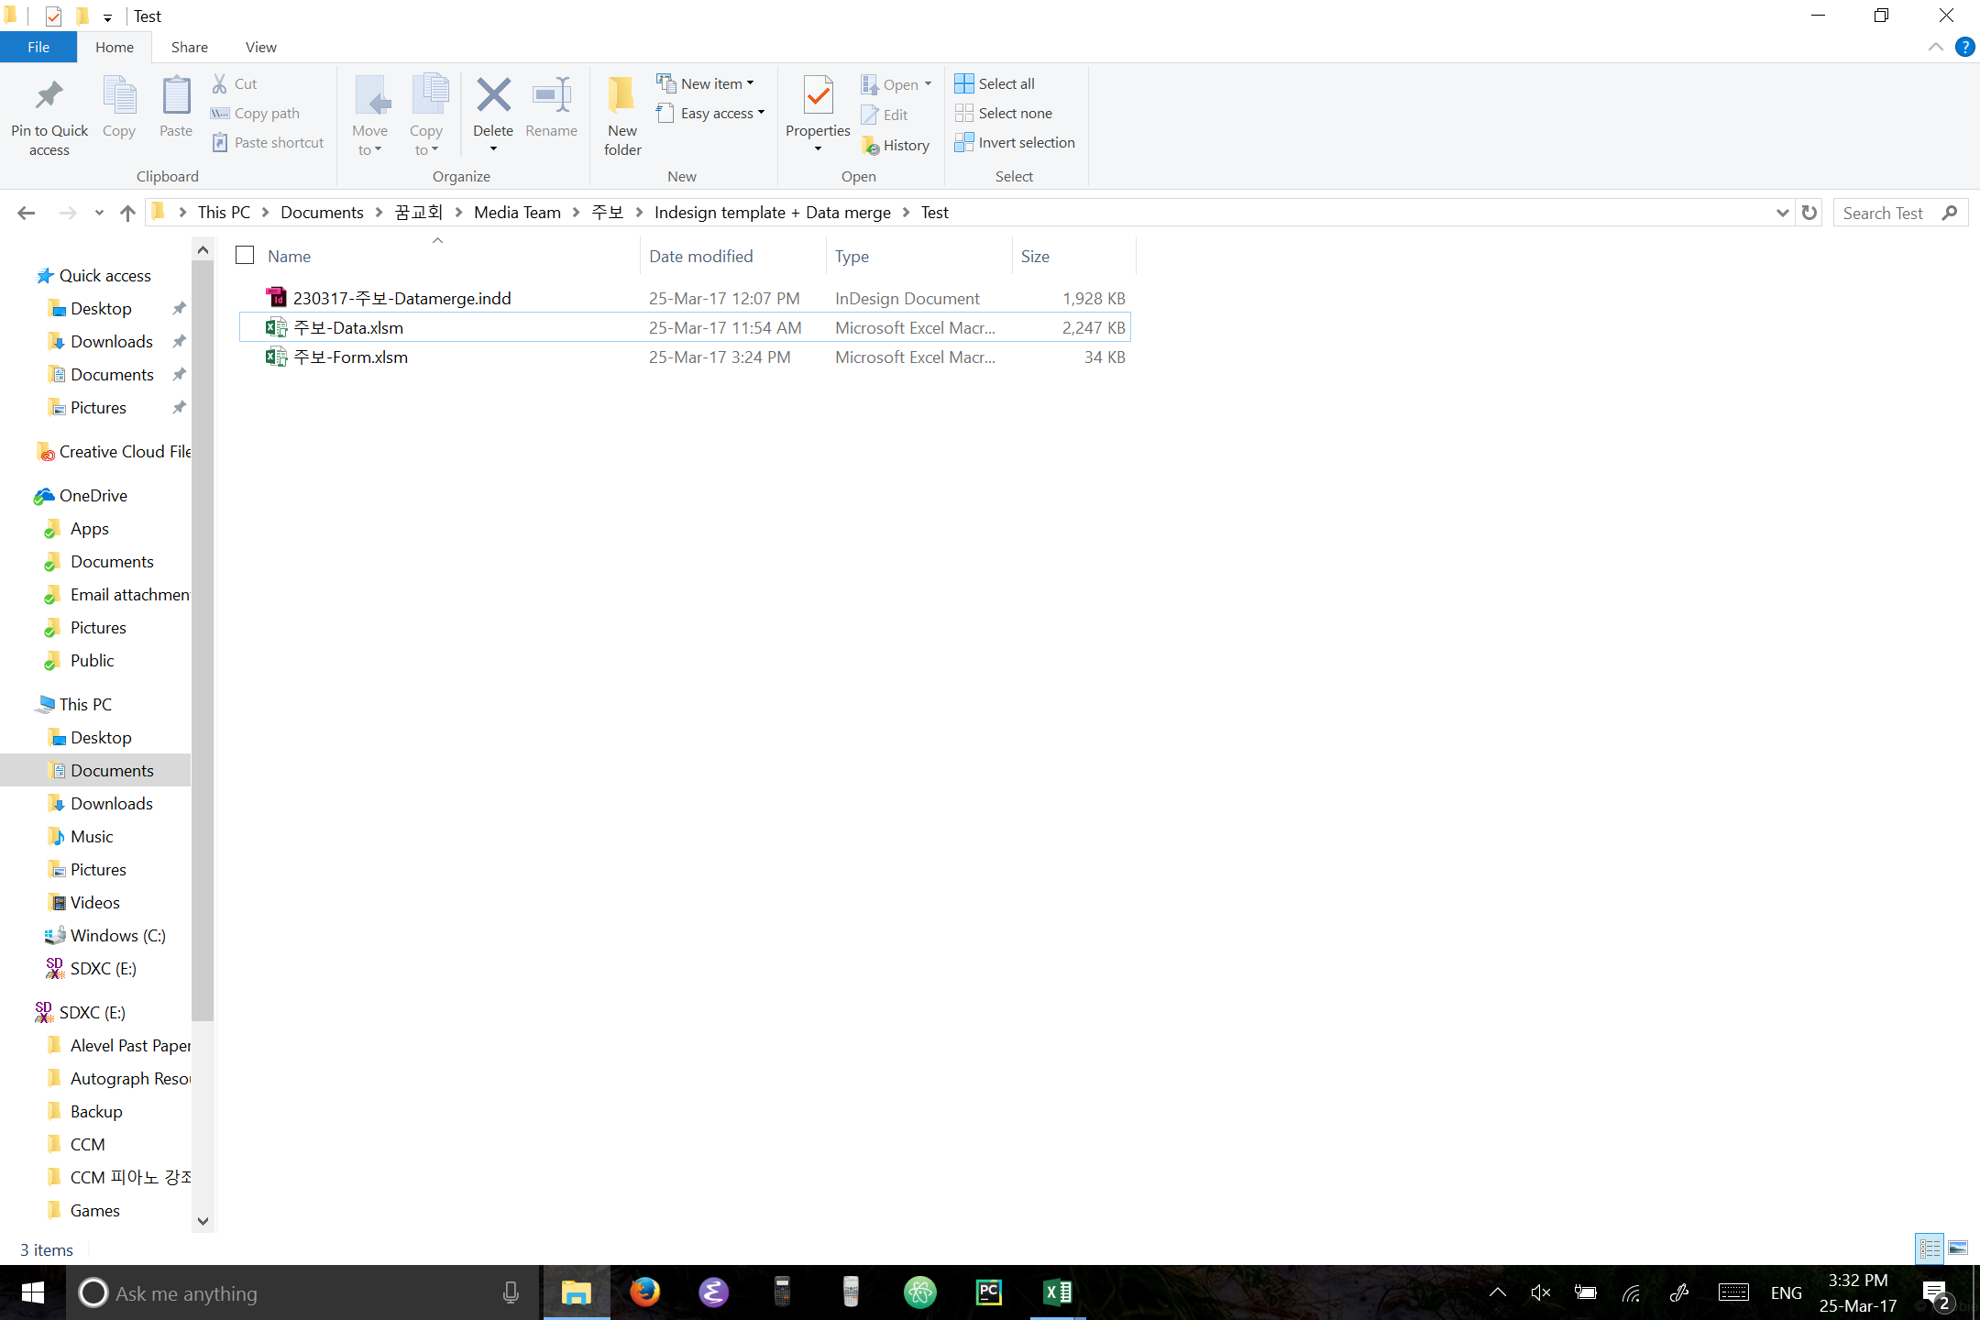
So you should have these files to begin.
Now open “주보-Data” and “주보-Form”

Slide 5
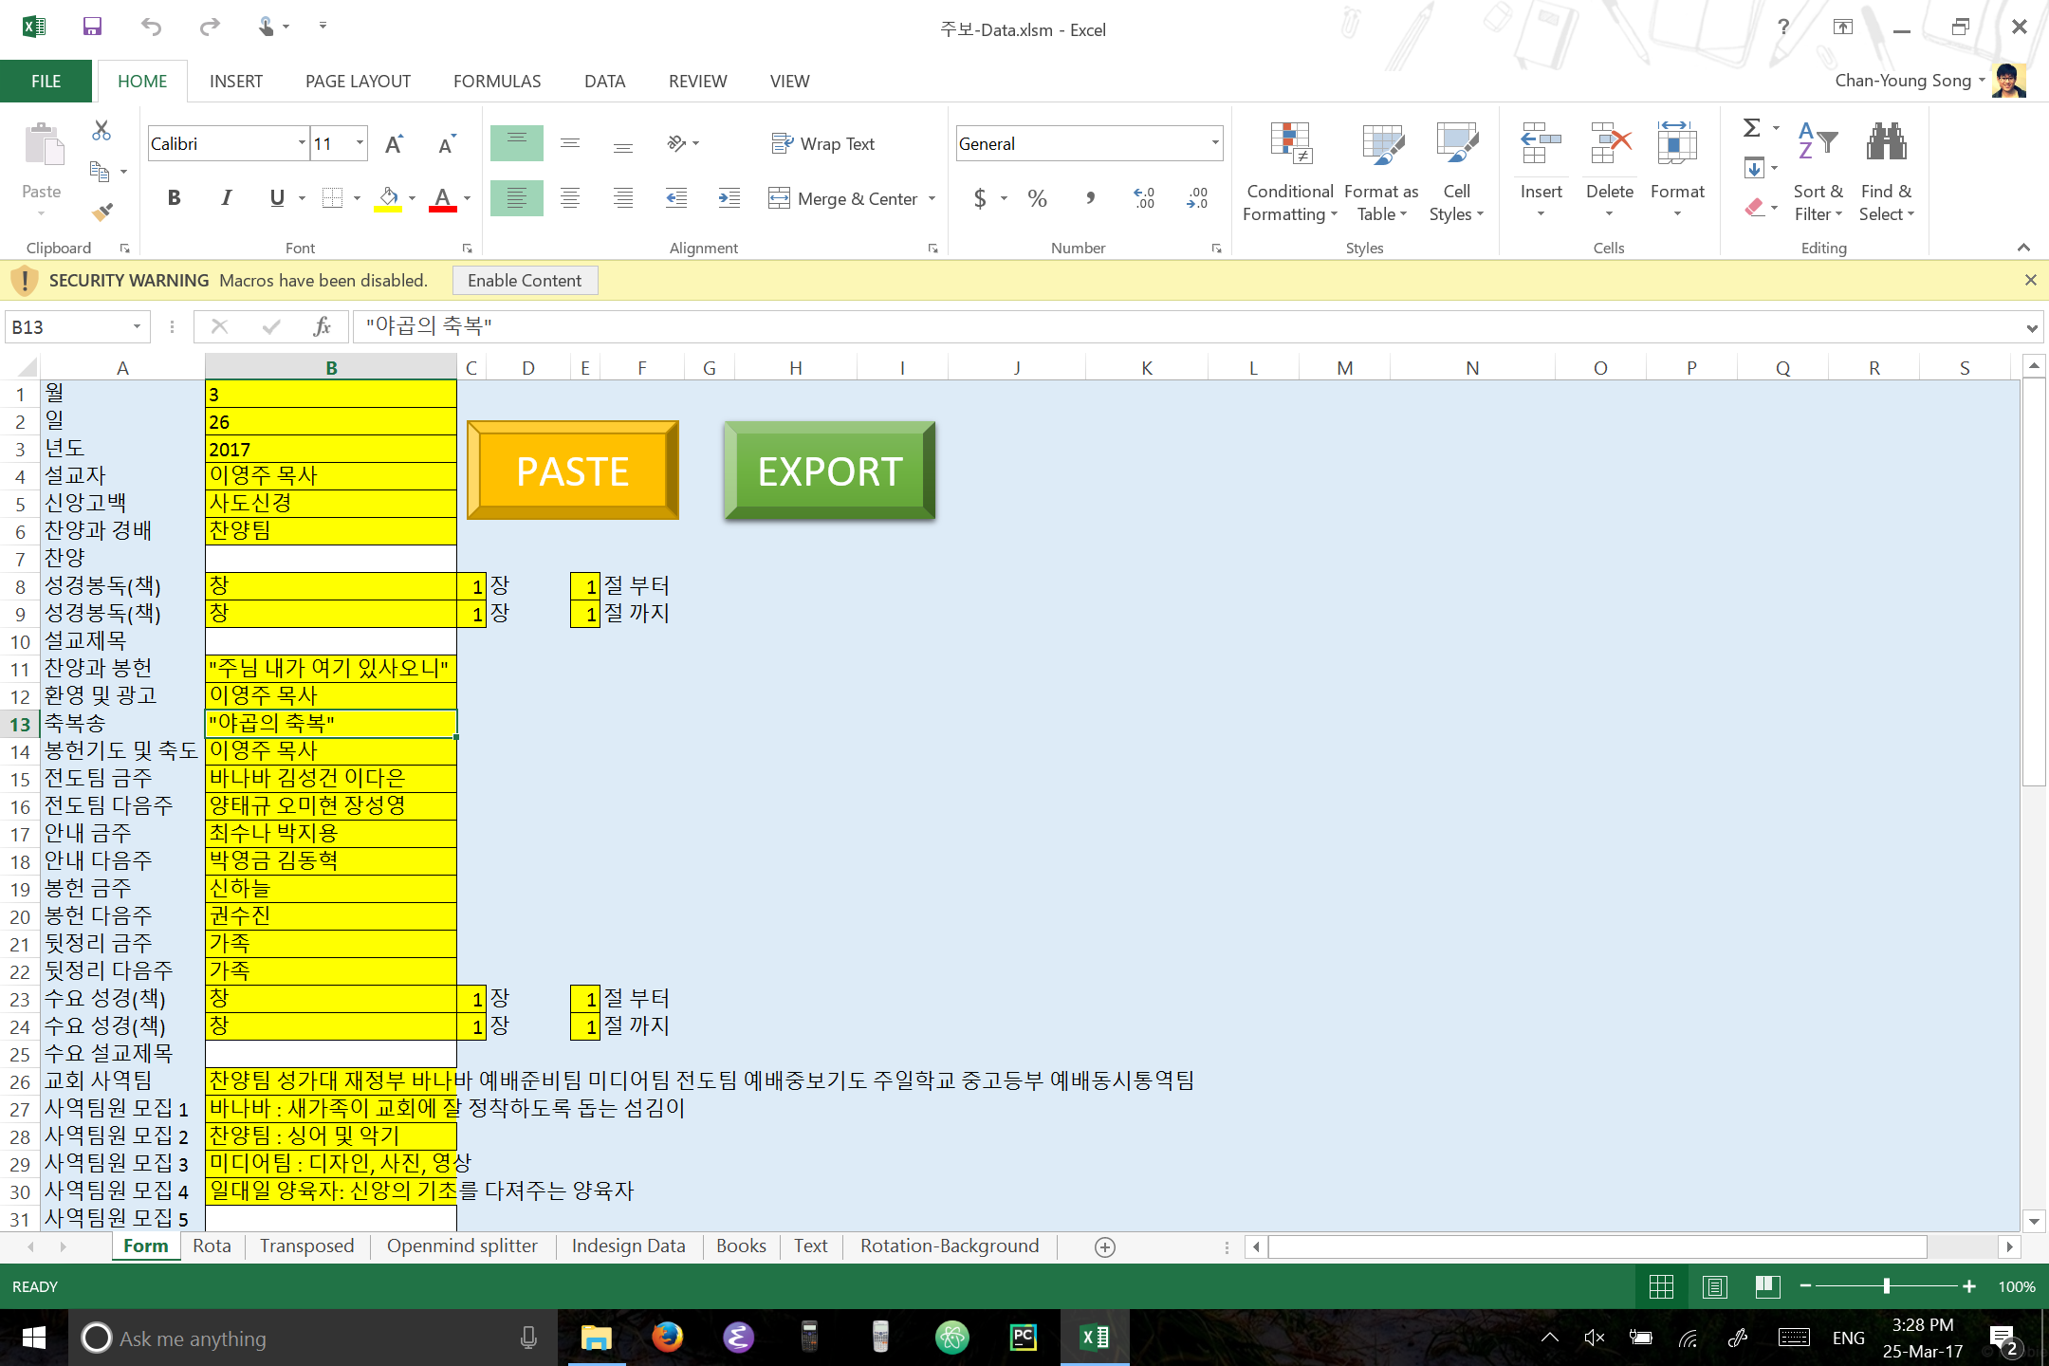
The excel files have macros and so you need to first click enable content if it asks for it.

Slide 6
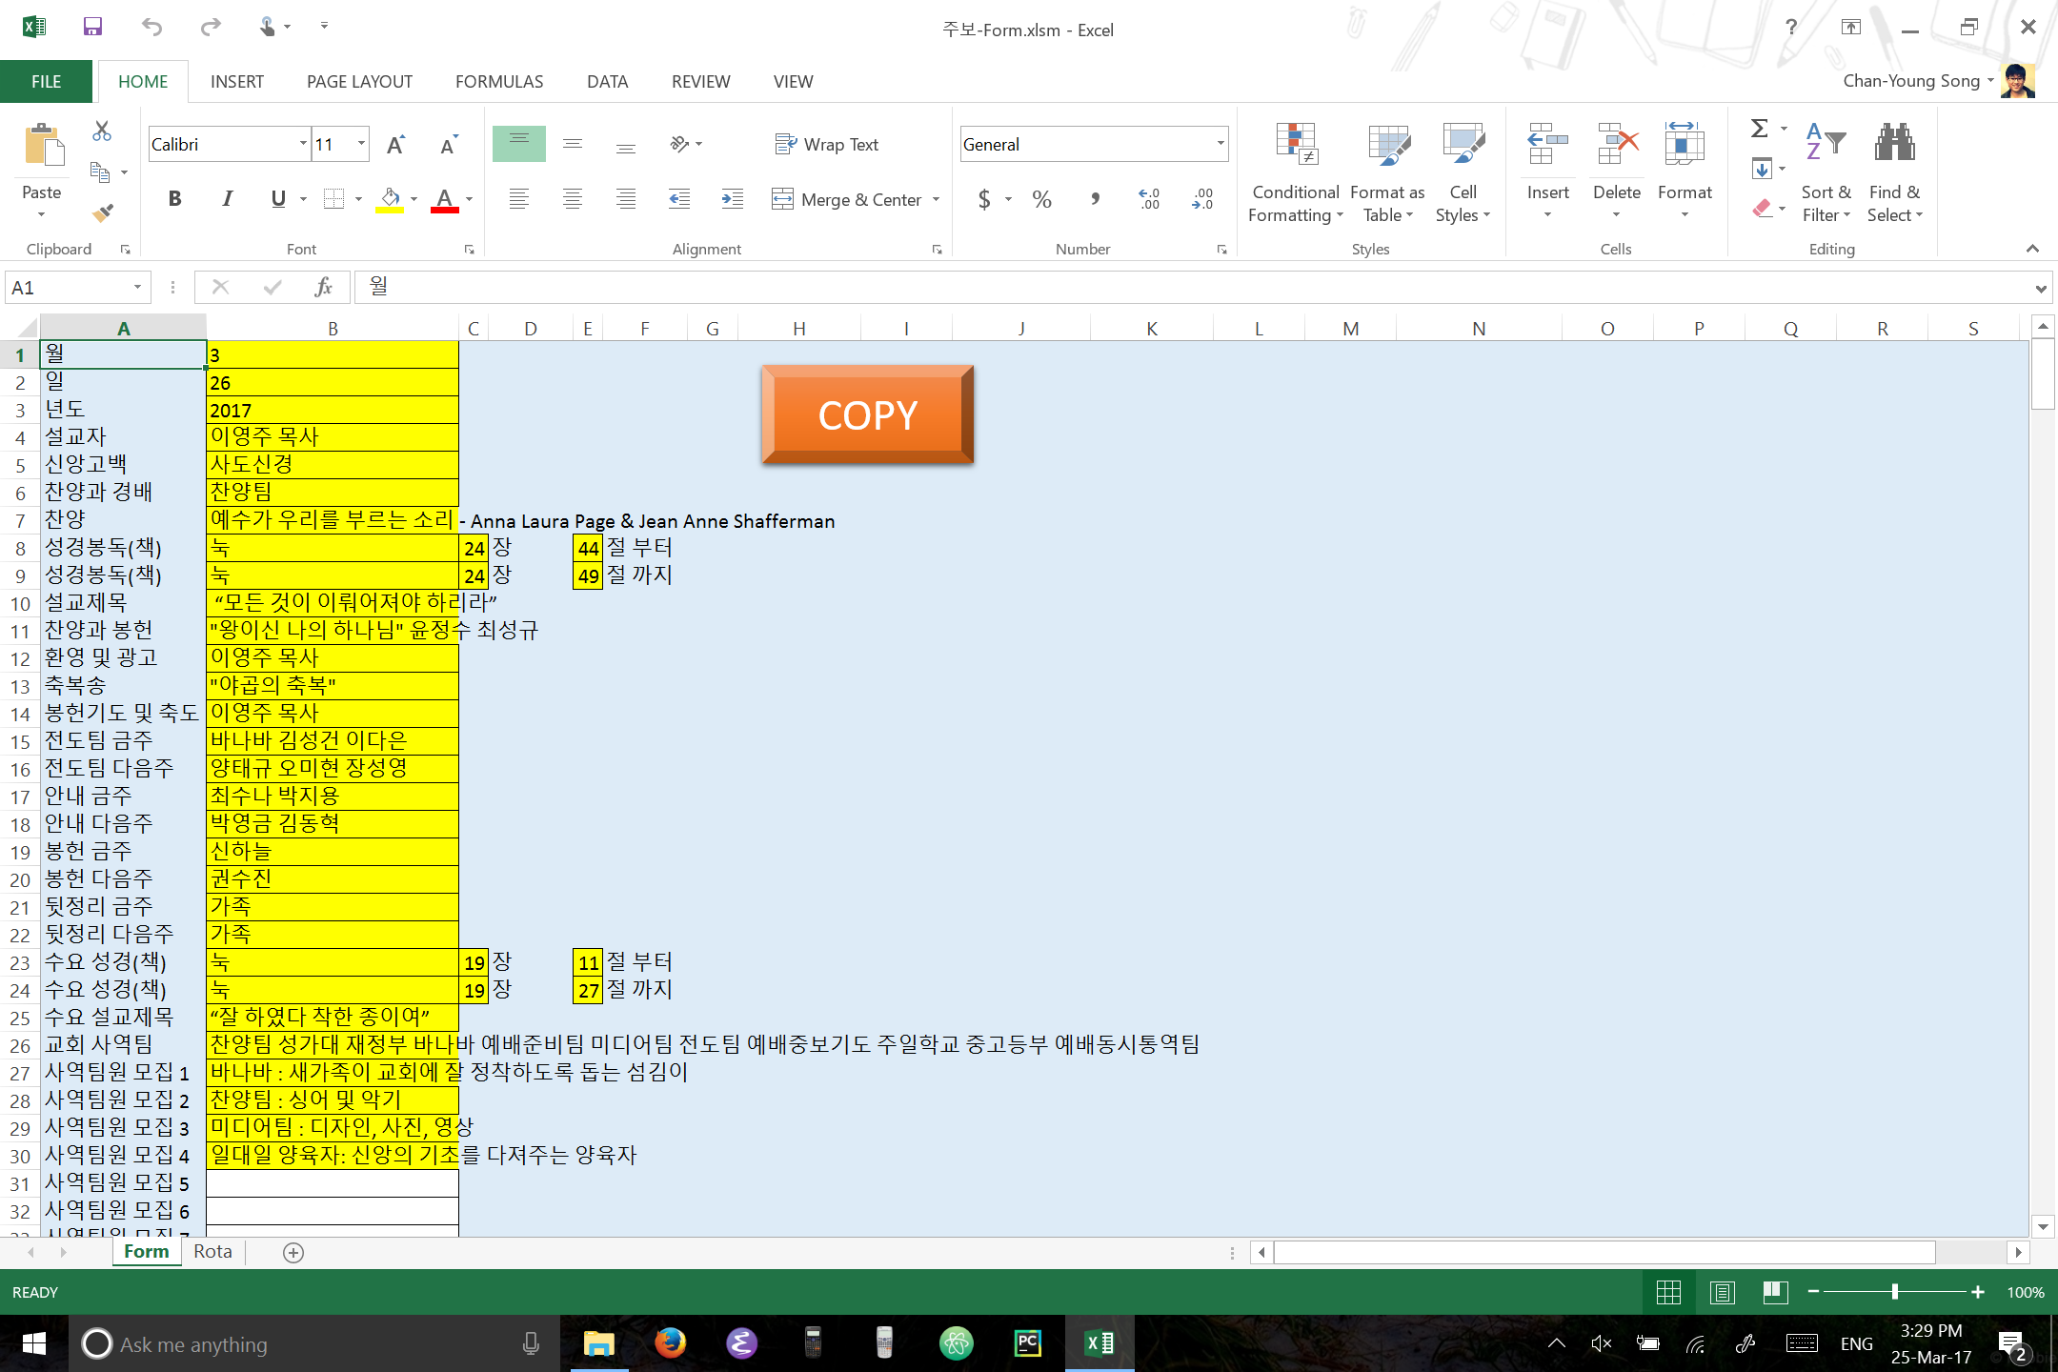
In “주보-Form”, click on “COPY” button.

Slide 7
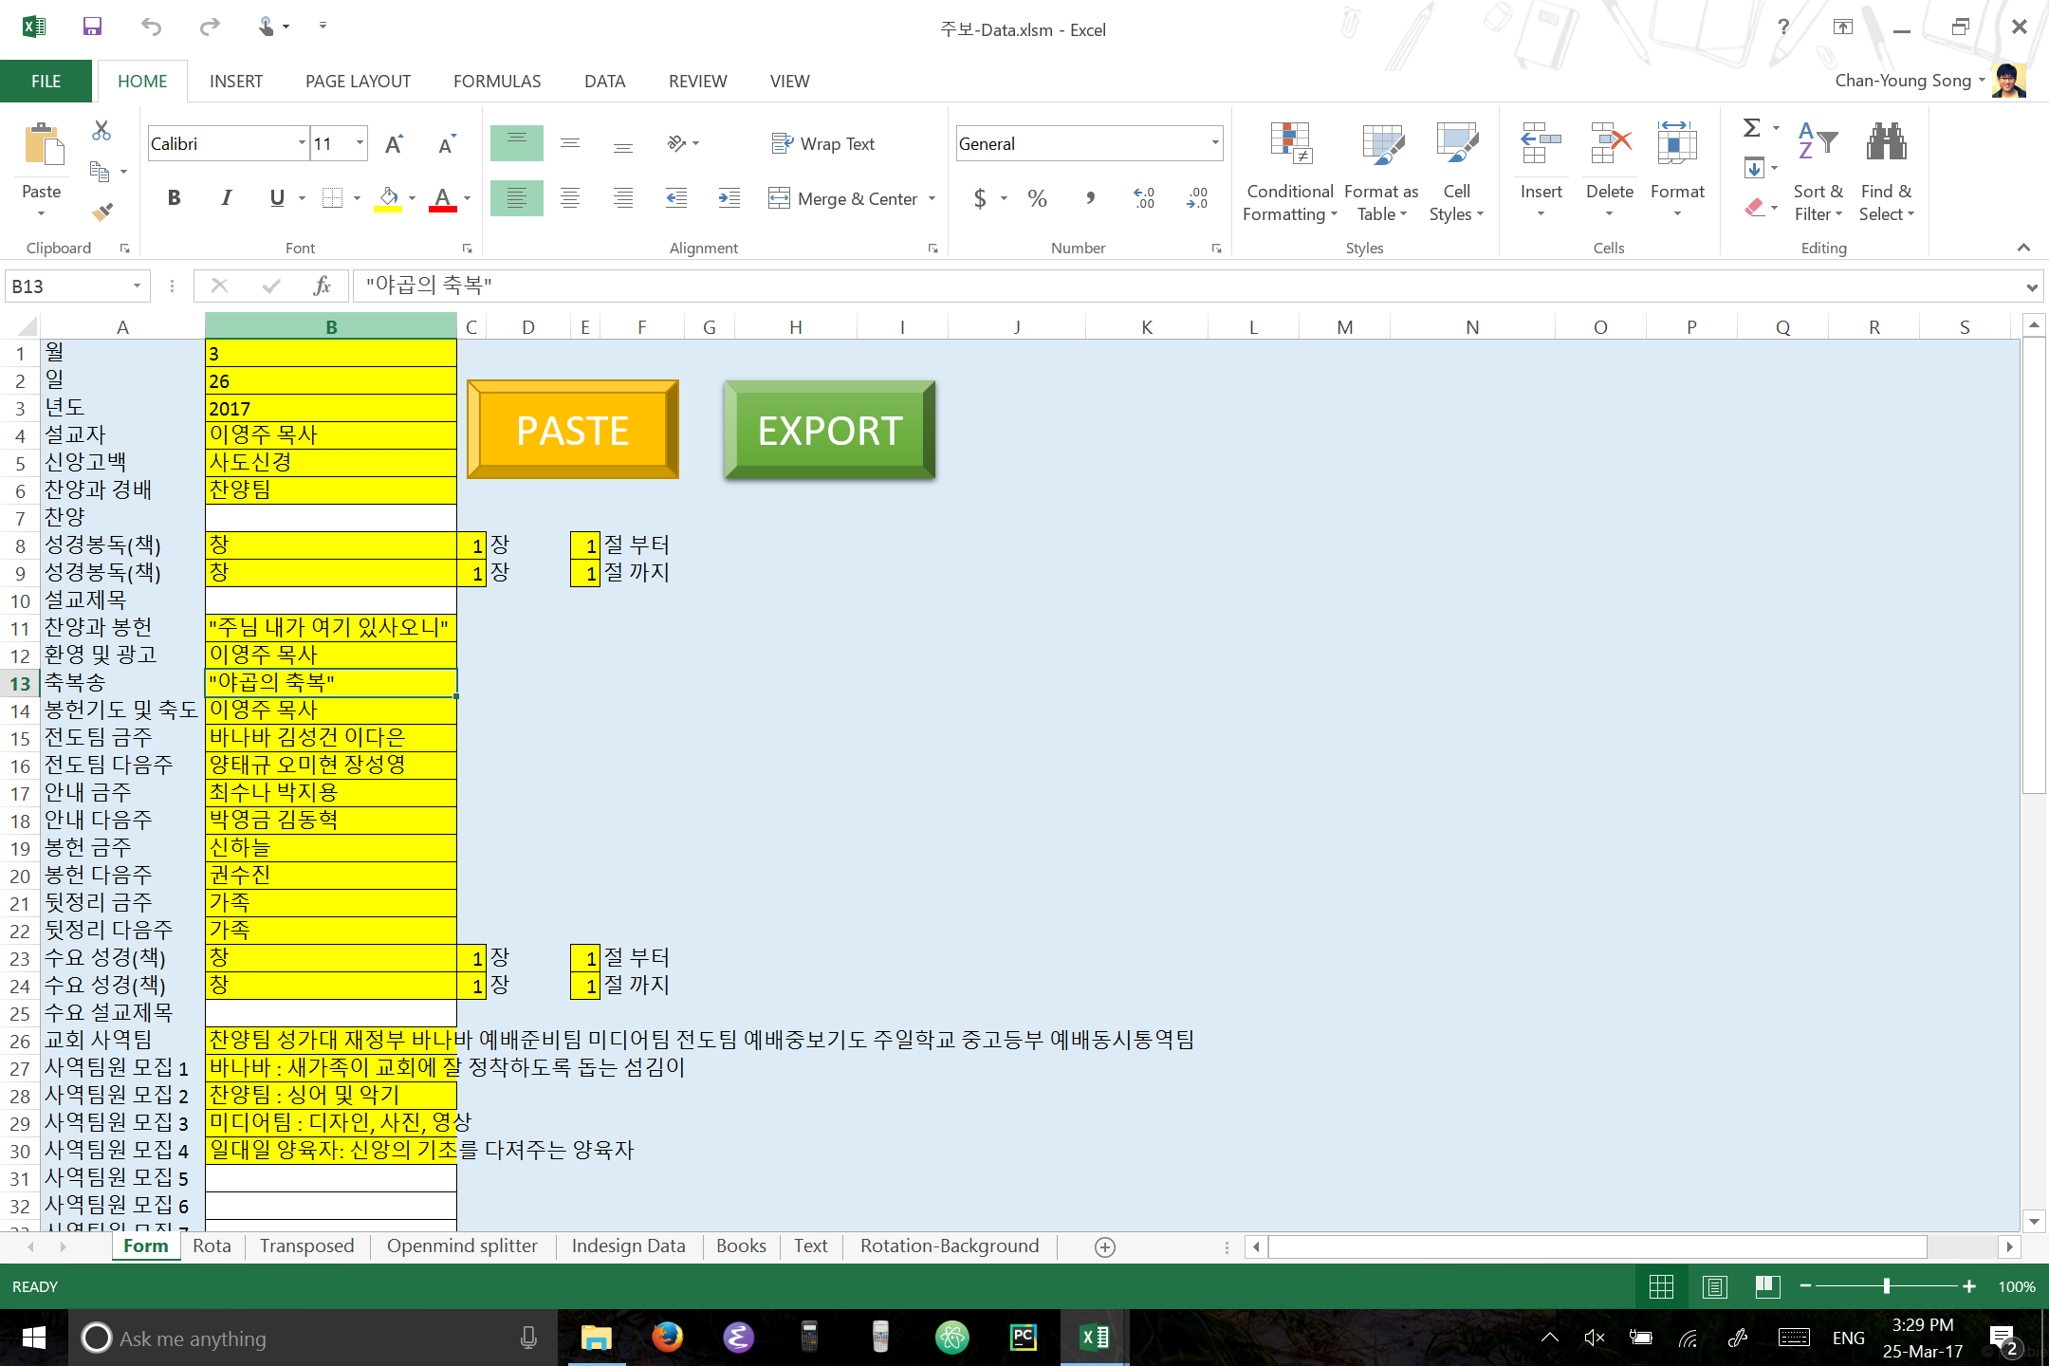
Now in “주보-Data”, click “PASTE” button.

Slide 8
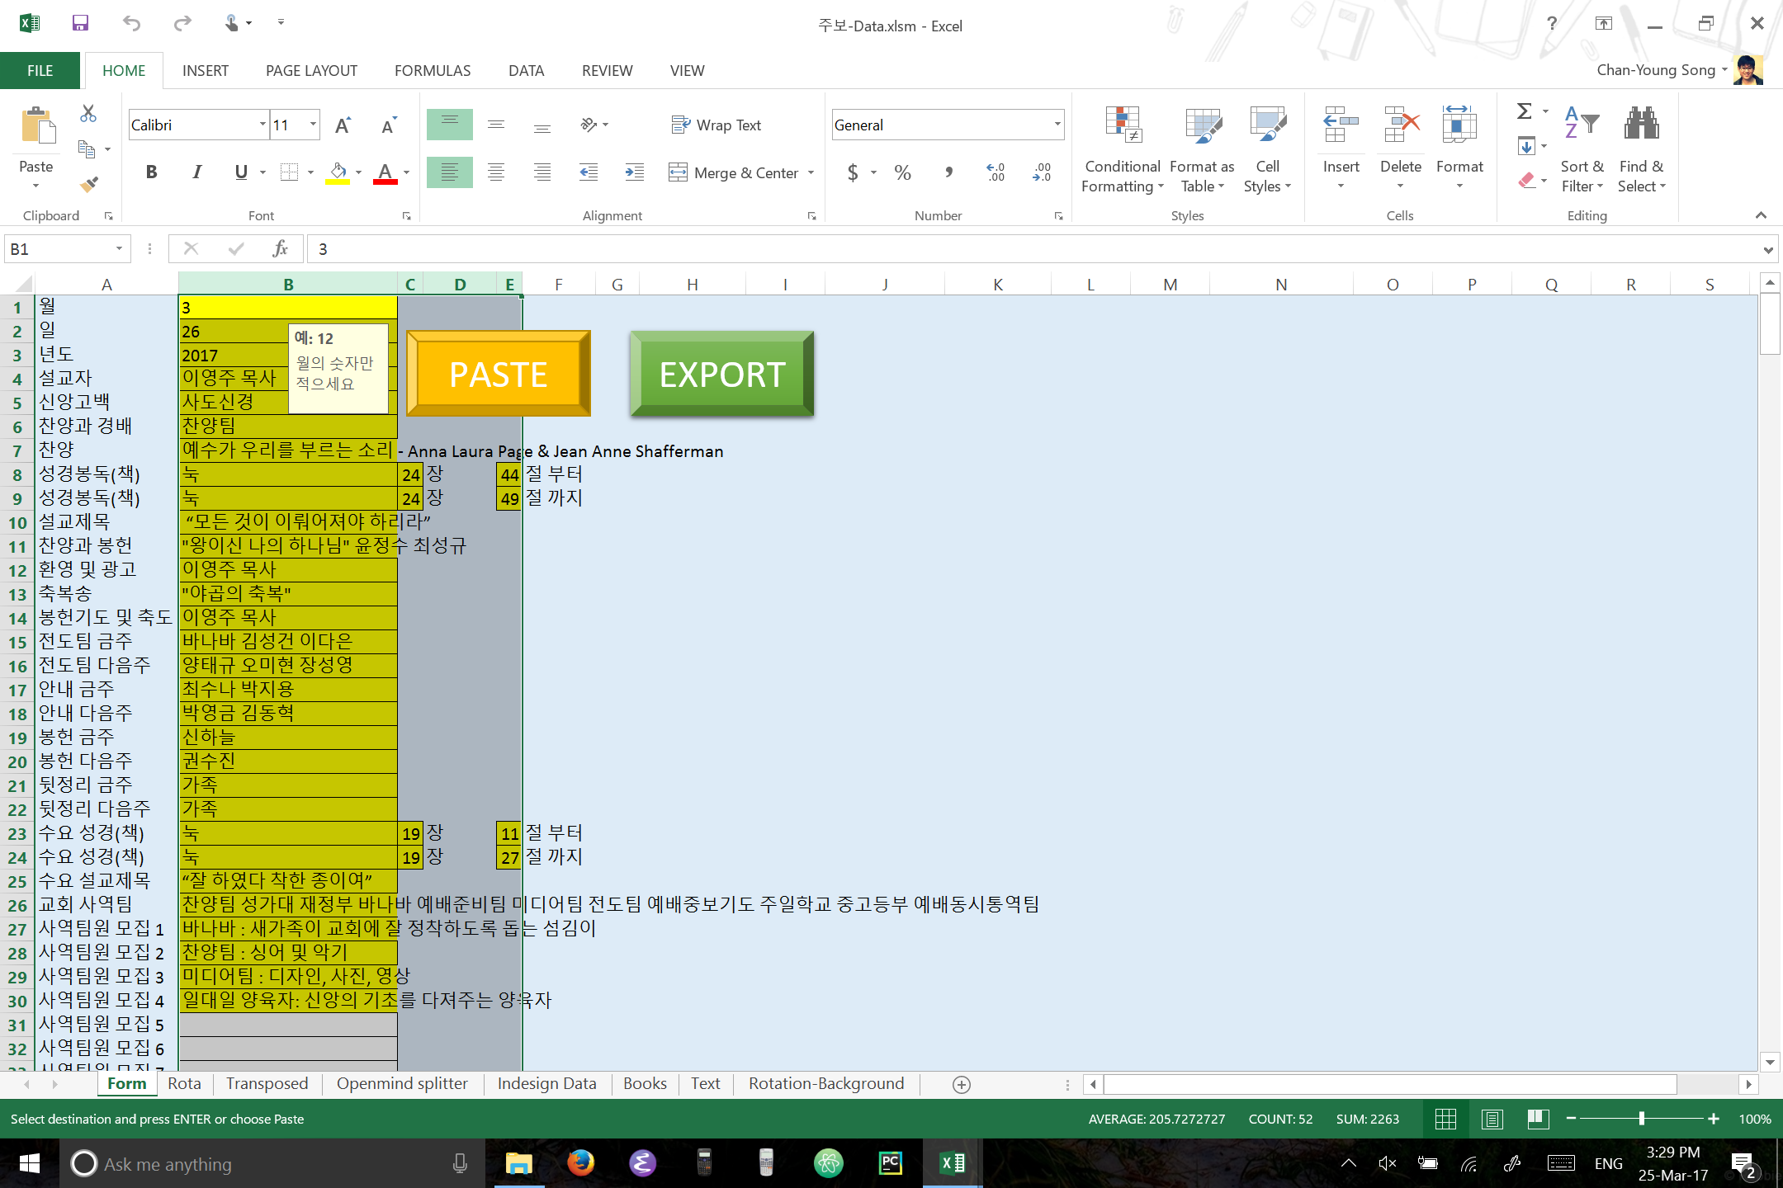
Then click “EXPORT” button.

Slide 9
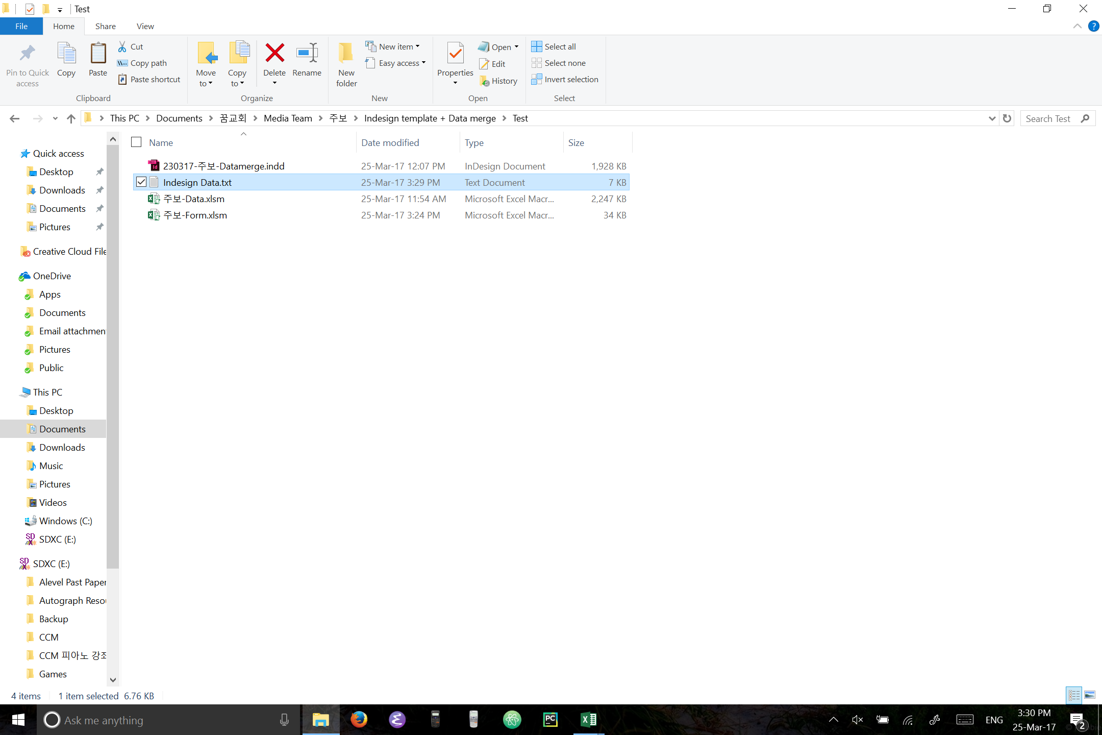
In the same folder as the “주보-Data” excel file, there should now be “Indesign Data” txt file. You don’t need to open this.
Now open the “주보-Datamerge” indesign file

Slide 10
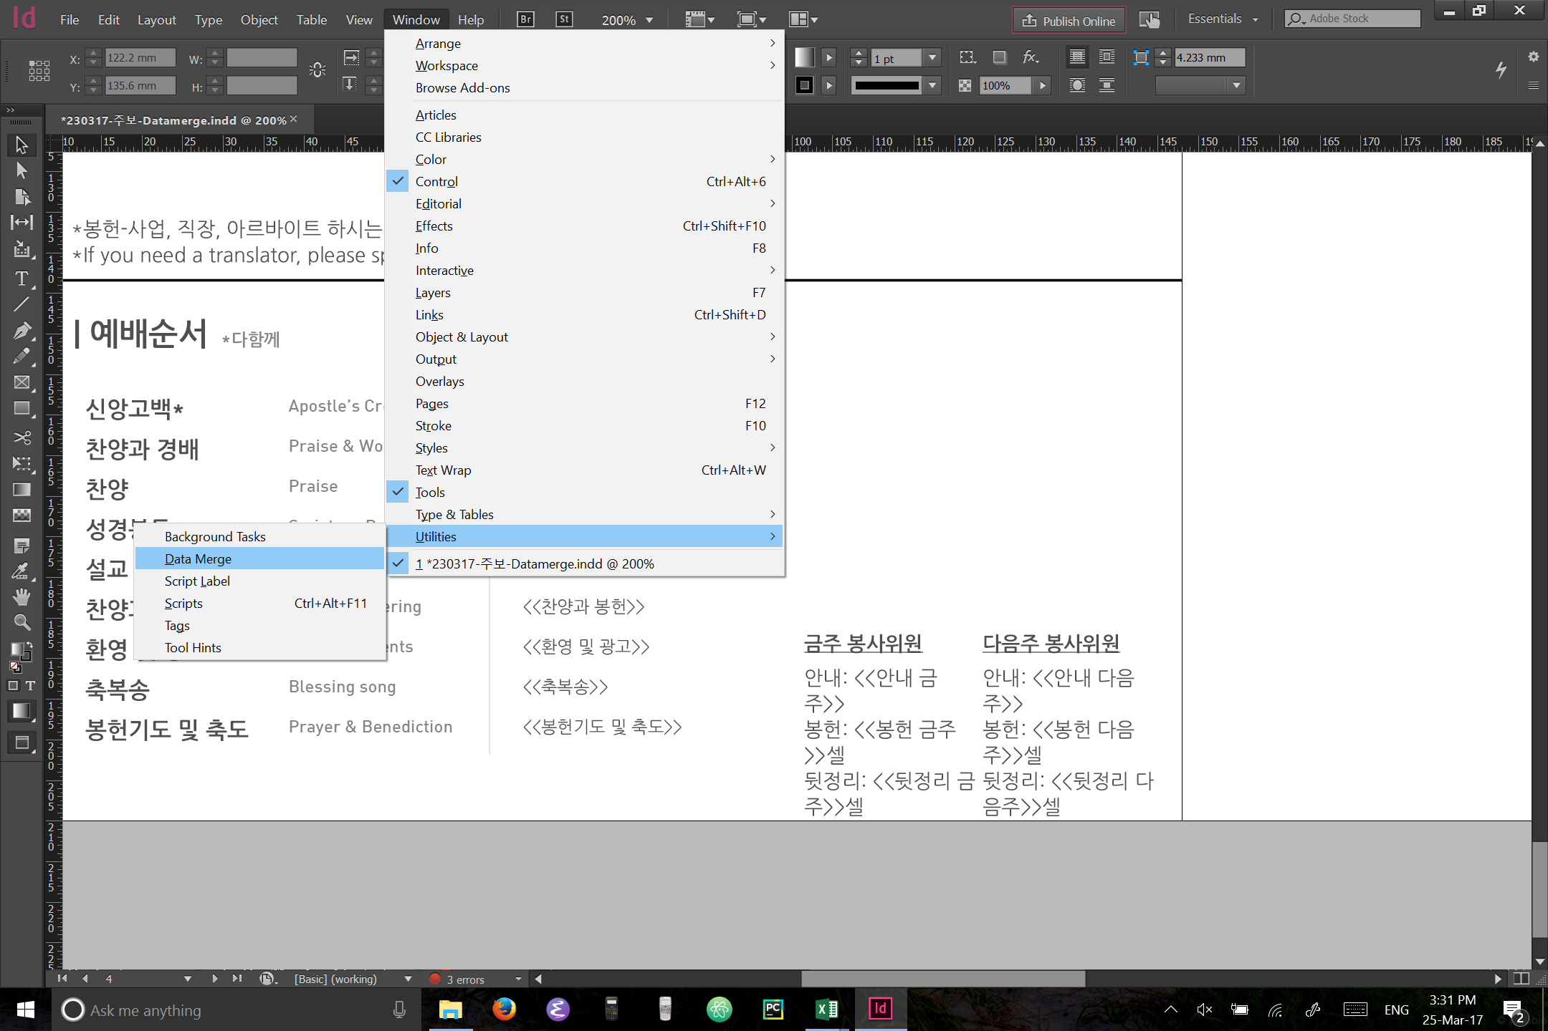
If you don’t see the datamerge pane already, go to: Windows -> Utilities -> Data Merge

Slide 11
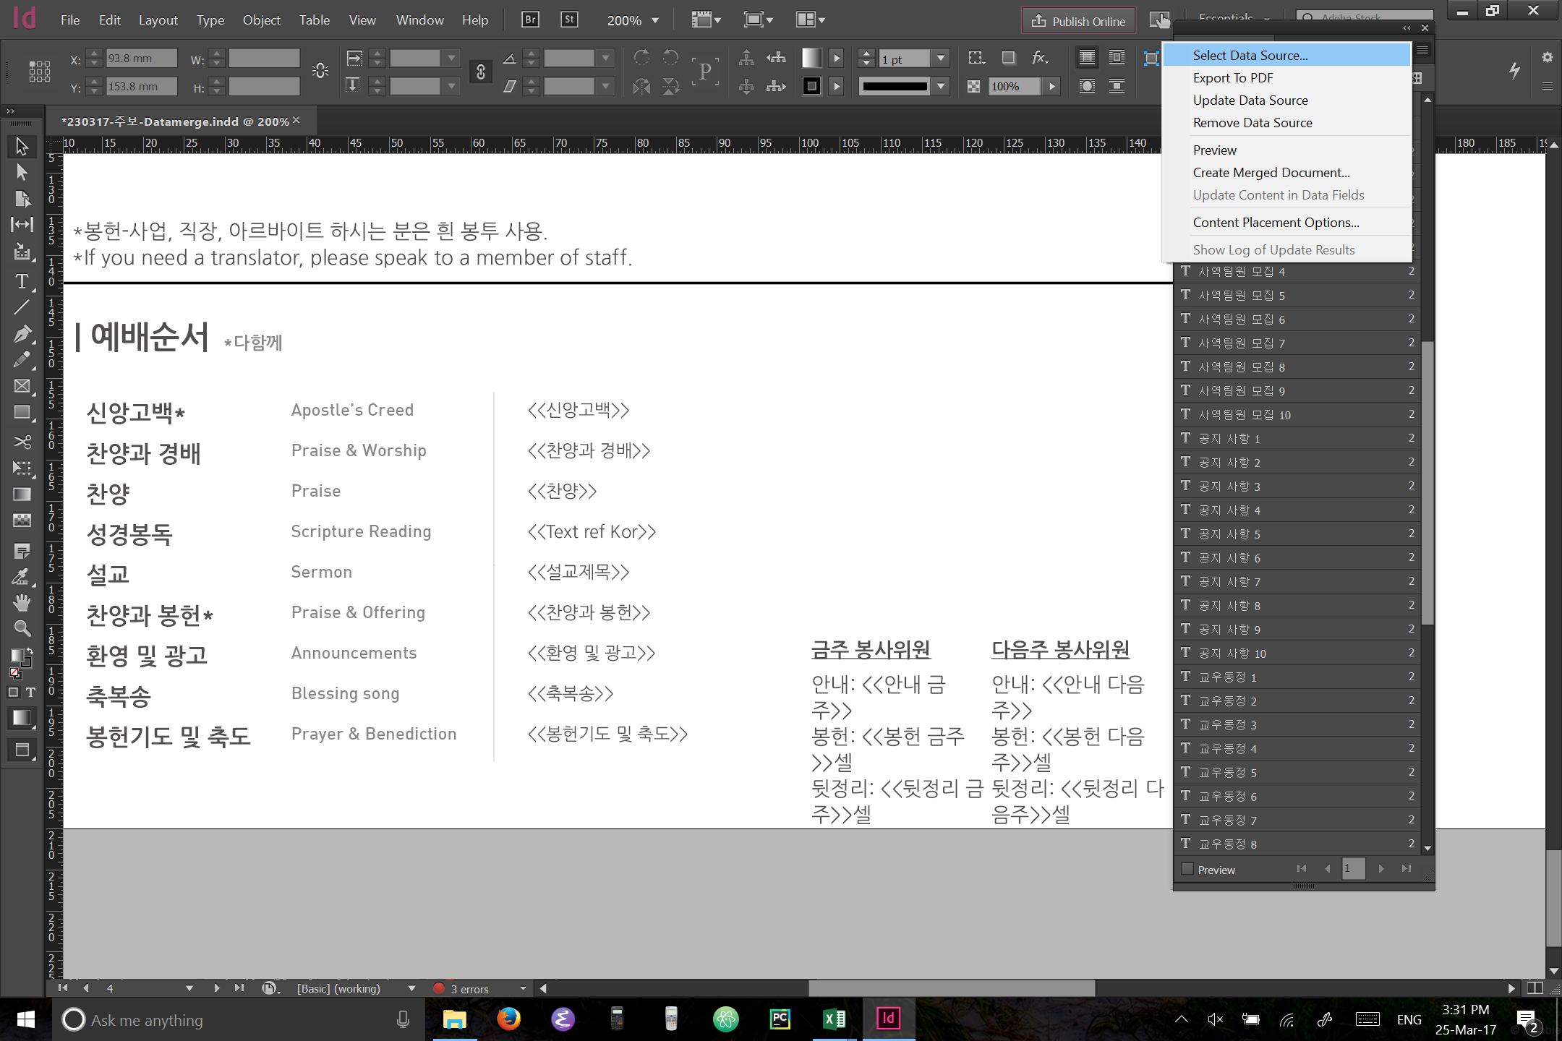
You should now see the data merge pane.
Now click the striped icon on the top right corner of the pane just under the cross then select “Select Data Source”

Slide 12
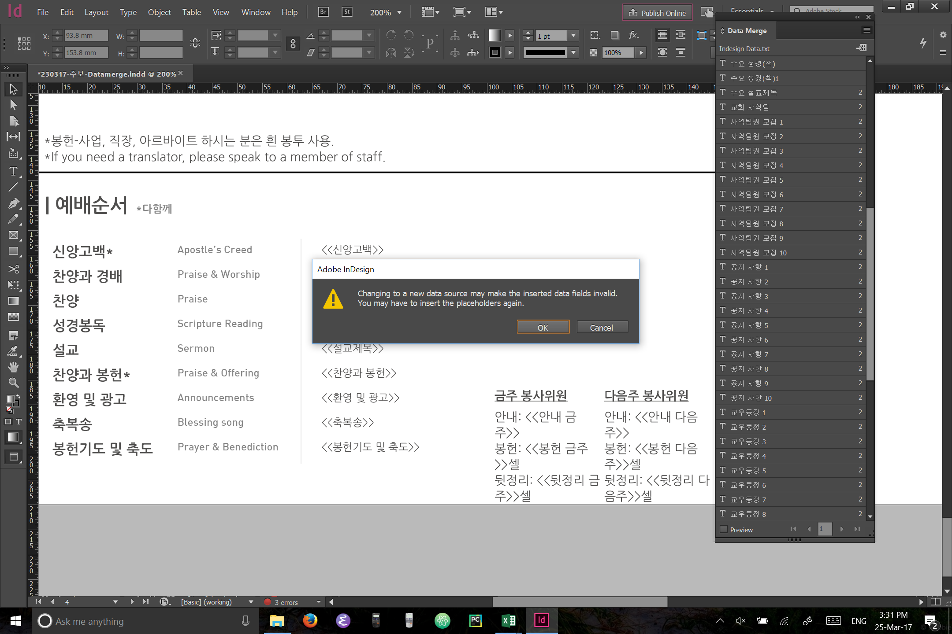
Click “OK” when you see this warning

Slide 13
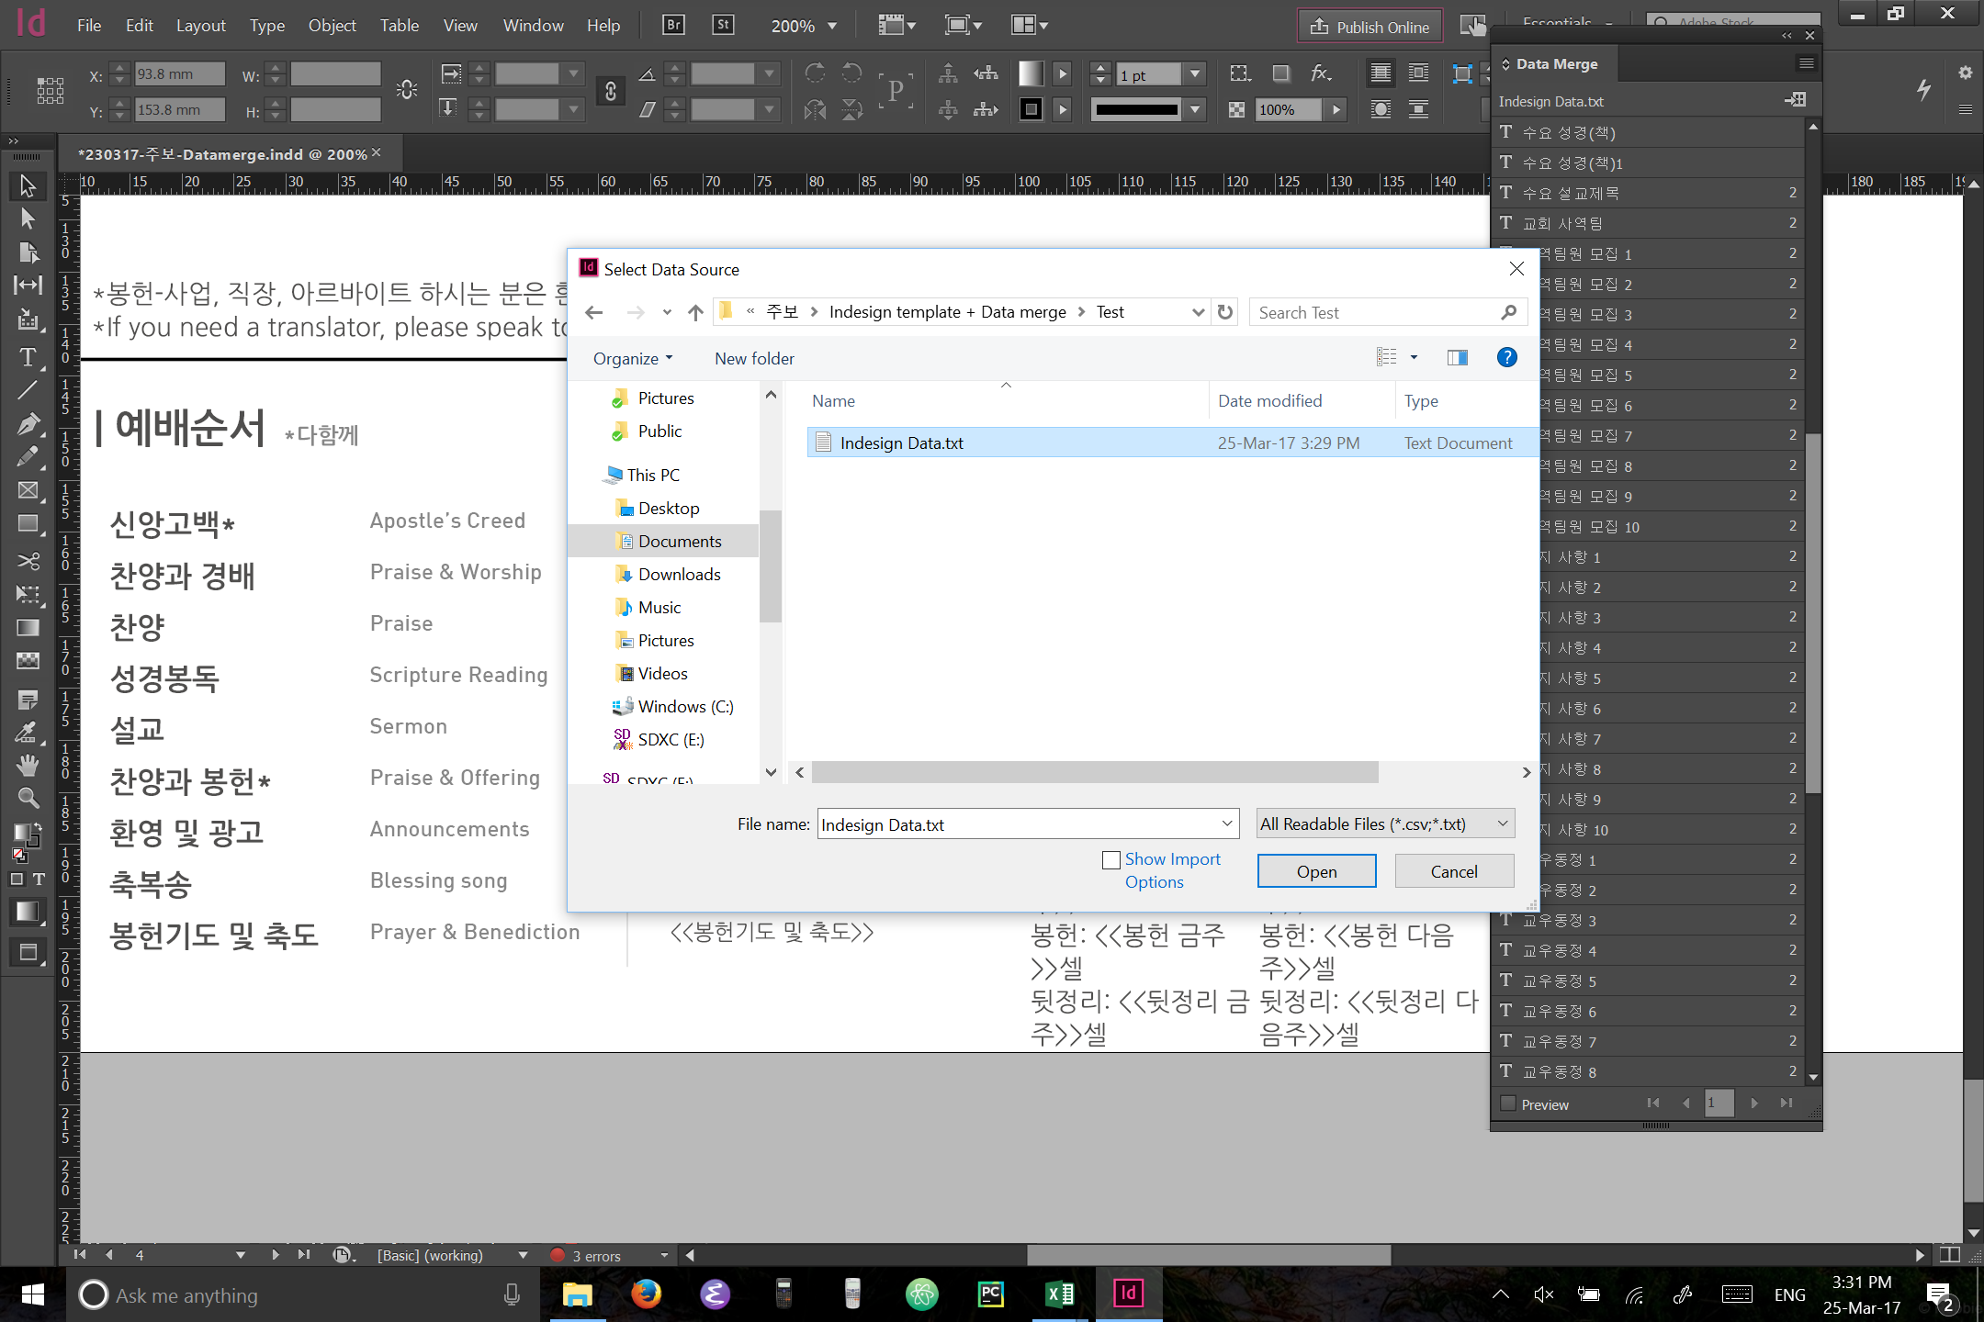
Now open the “Indesign Data” text file we created.

Slide 14
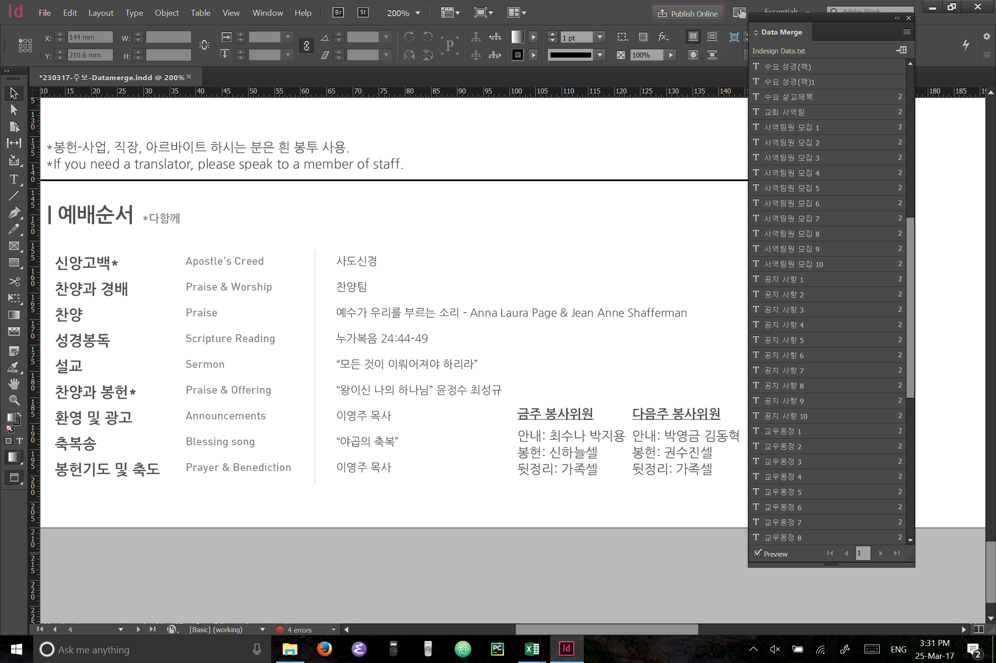
If you click preview at the bottom Left corner, you will see the preview after datamerge.

Slide 15

To produce the indesign file after datamerge, click on the button below the striped icon.

Slide 16
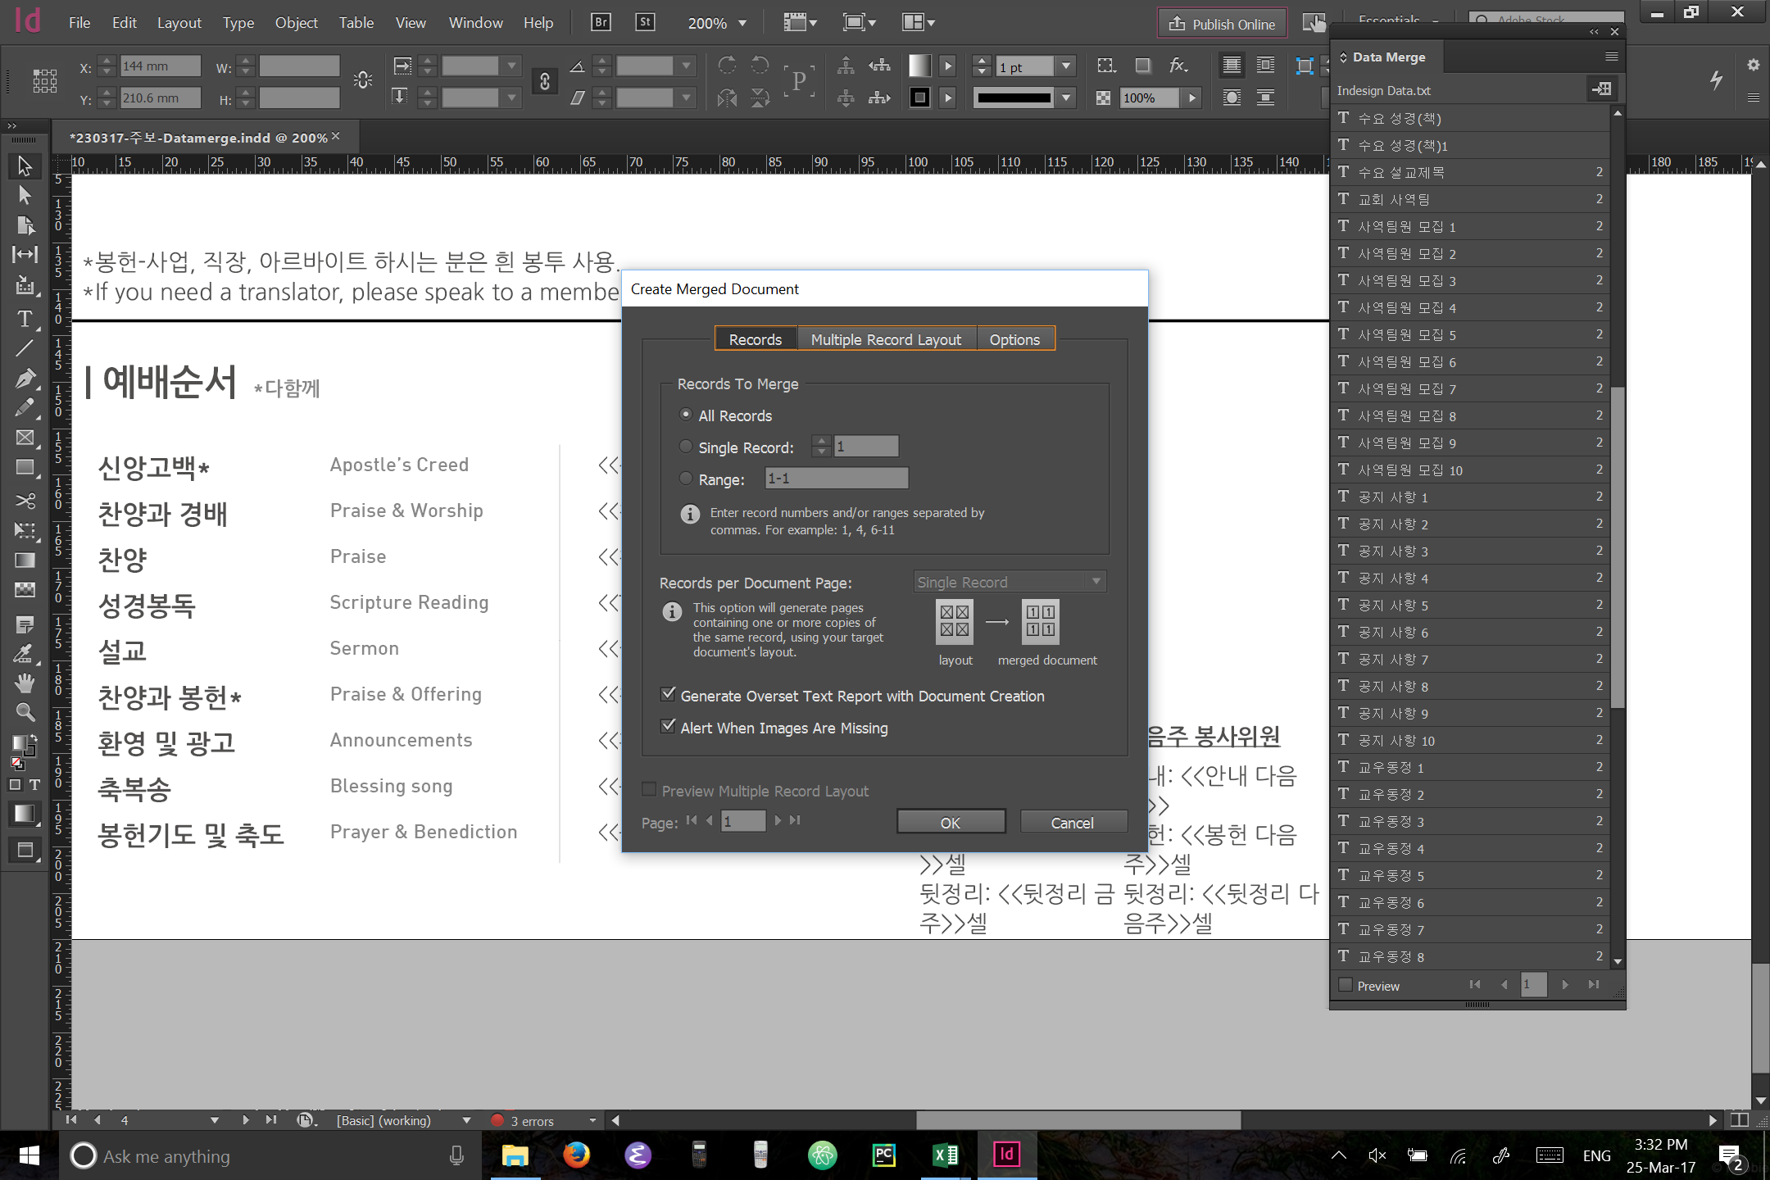
Now click OK

Slide 17
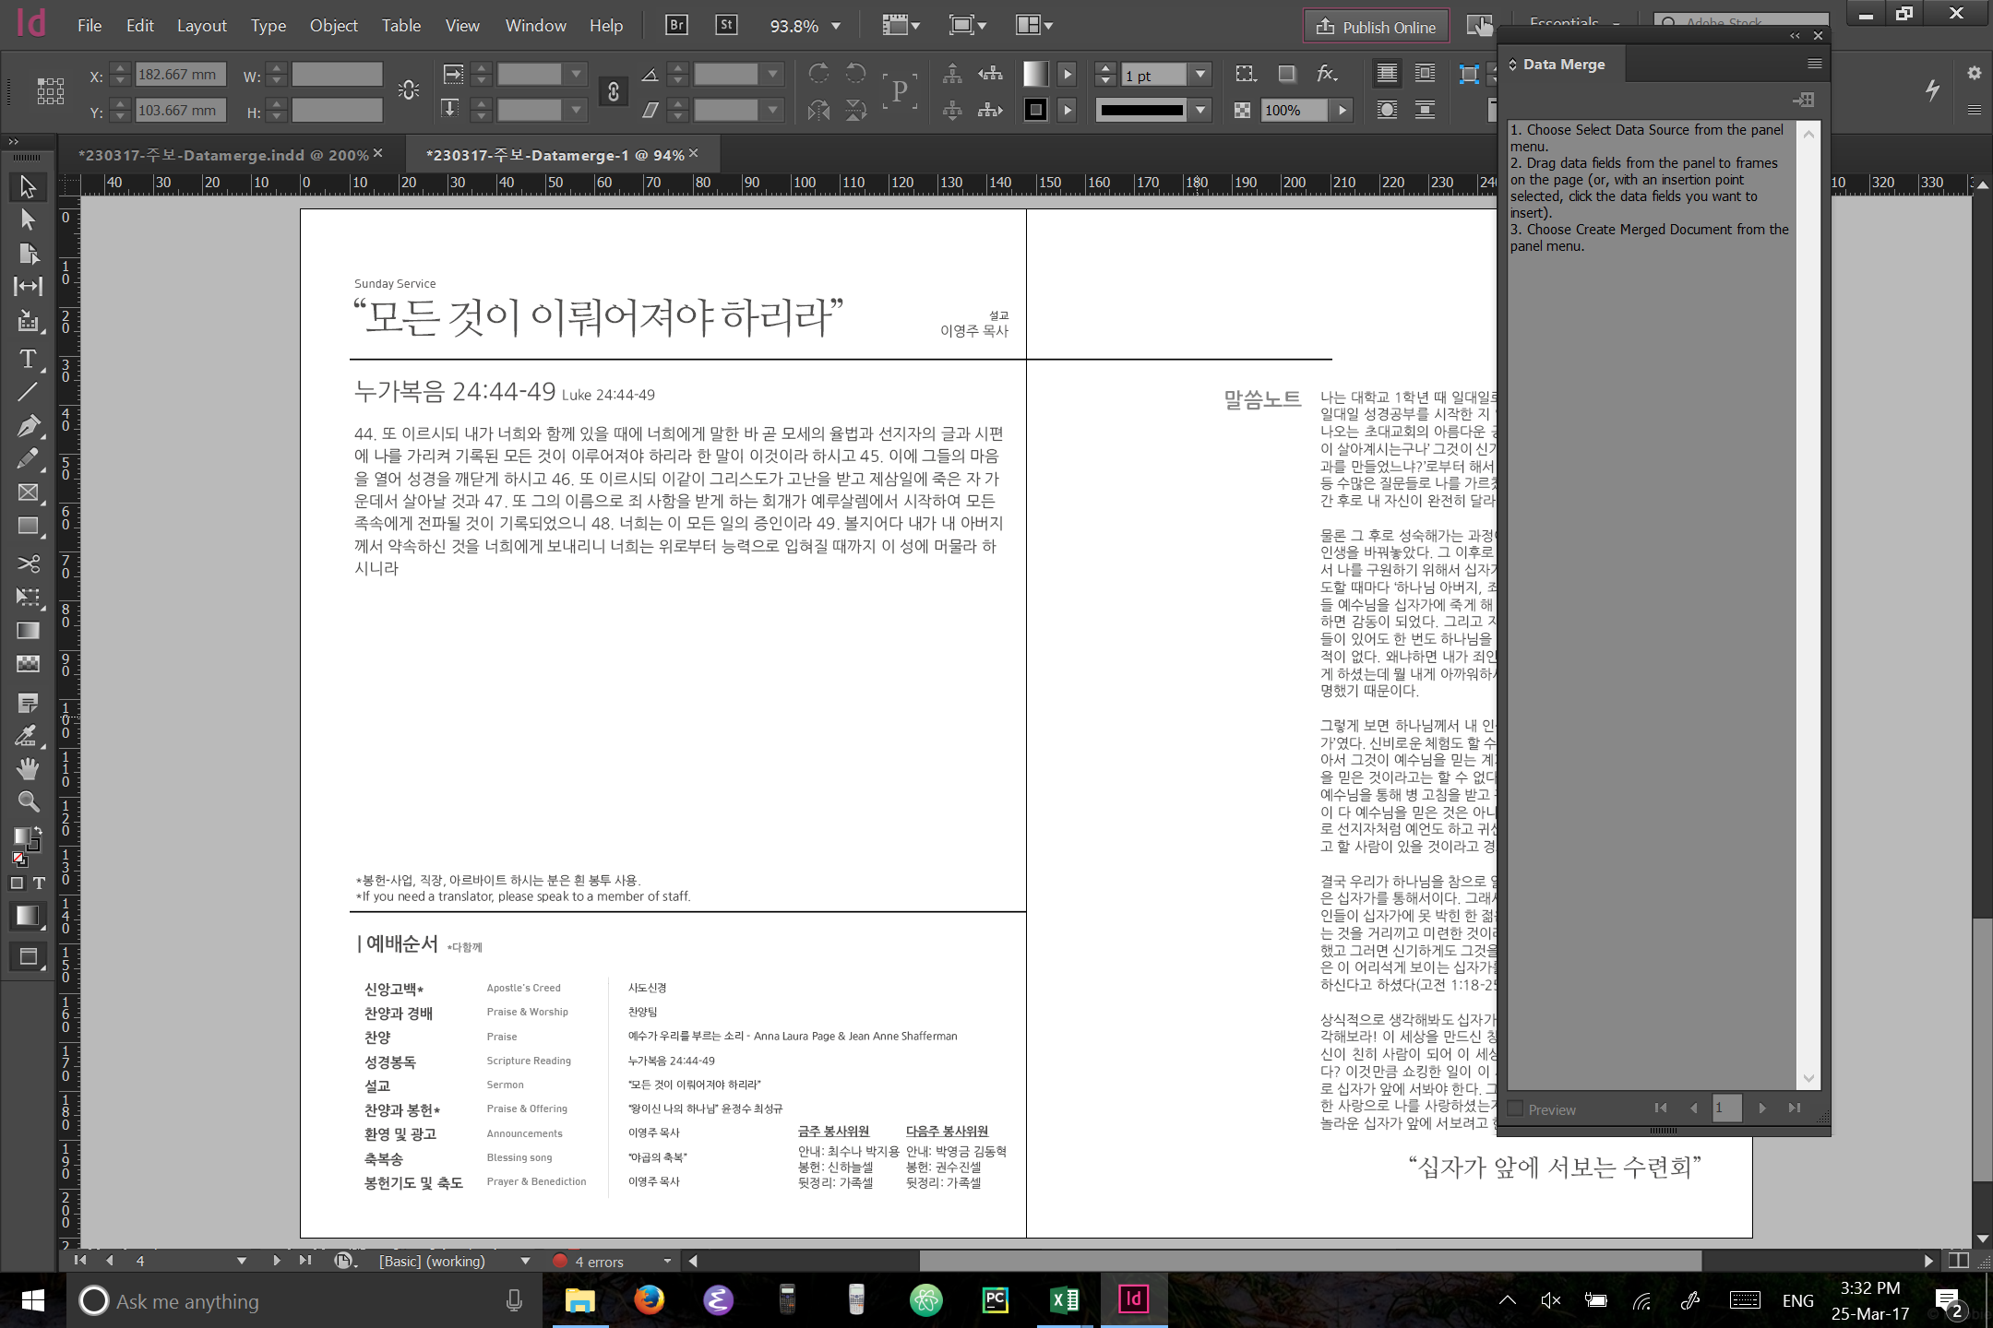
This will produce a new indesign file after datamerge.
Feel free to edit further if necessary.
Then export as usual

Slide 18
Done!
Let 찬영 know of any problems, questions or suggestions

